Slide 1
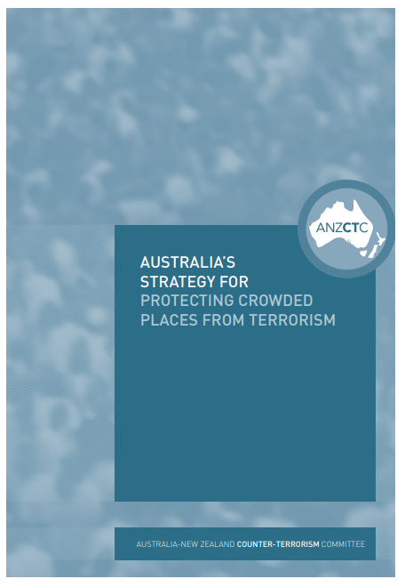
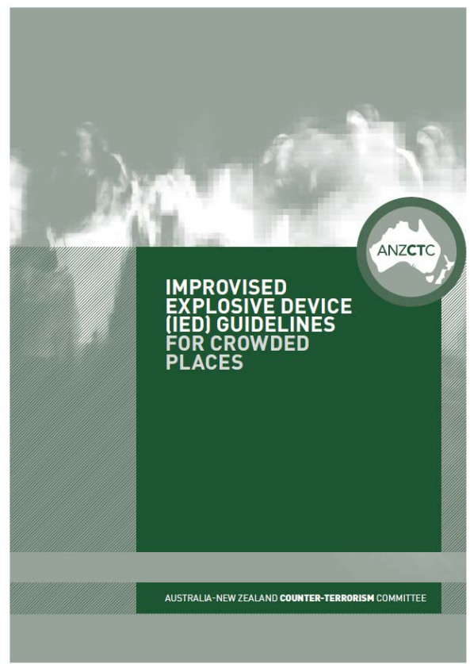
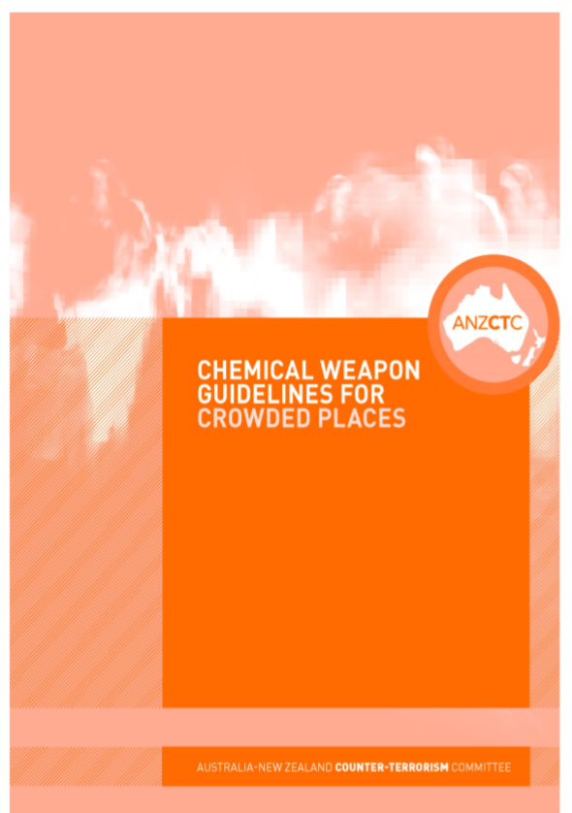
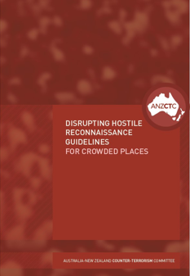
Notes:
Supplementing the Strategy are more specific guidelines, which can be found at the National security website:
AAO Guidelines
IED Guidelines
Chemical Weapons Guidelines
Hostile Vehicle Guidelines
Disrupting Hostile Reconnaissance Guidelines

Slide 2
Owners & operators
Responsibilities
Duty-of-care to protect their sites
Undertake risk and/or vulnerability assessments
Implement risk mitigation strategies
Regularly audit risk and security plans
Regularly test security plans
Understand the current Terrorist Threat Environment - POSSIBLE
Report all security incidents
Notes:
Duty-of-care to protect their sites
Undertake risk and/or vulnerability assessments
Implement risk mitigation strategies
Regularly audit risk and security plans
Regularly test security plans
Understand the current Terrorist Threat Environment - POSSIBLE
Report all security incidents

