Slide 1
Small things, Big Impact
VMA Conference 2023

Slide 2
A worldwide movement of inclusion
"Inclusion as a concept encompasses more than just an individual’s presence within a particular setting, rather that the individual perceives themselves as belonging within the setting, whilst being authentically themselves and not needing to change who they are in order to ‘fit in’"
Notes:
First Session: Emma
Second session: Nyx

Slide 3
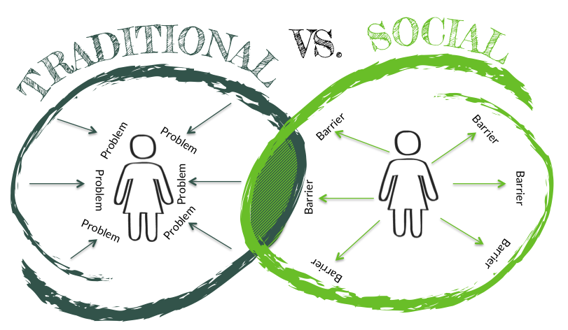
Social model of disability
Traditional: History of deficit ‘can’t do’ approaches & low expectations
Social: Moving towards removing barriers in the physical and social environments
Notes:
Traditionally autism has been seen only in terms of deficits and it has based the problem in the person
First Session: Emma
Second session: Nyx

Slide 4
Autism Friendly
The Aspect Autism Friendly team consults with a wide range of organisations including major venues, airports, shopping centres, retail stores, museums, art galleries, libraries, zoos and sport
Our team consists of Autistic and non-autistic people working in partnership
Our work is based on the Autism Friendly Framework

Slide 5
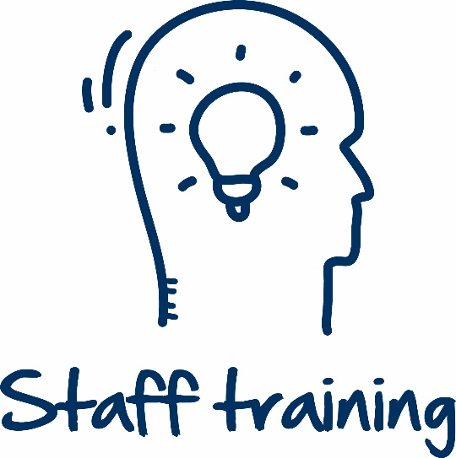
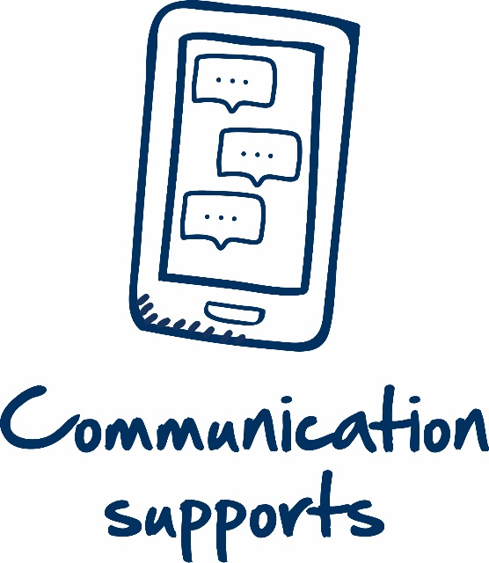
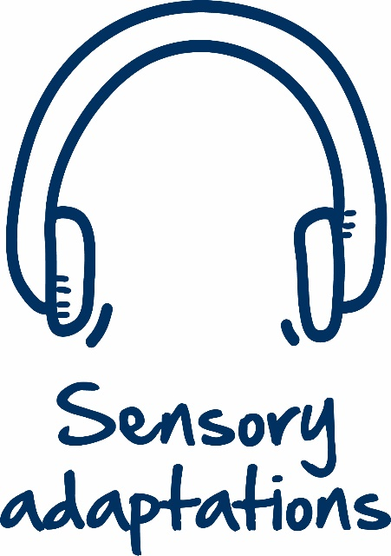
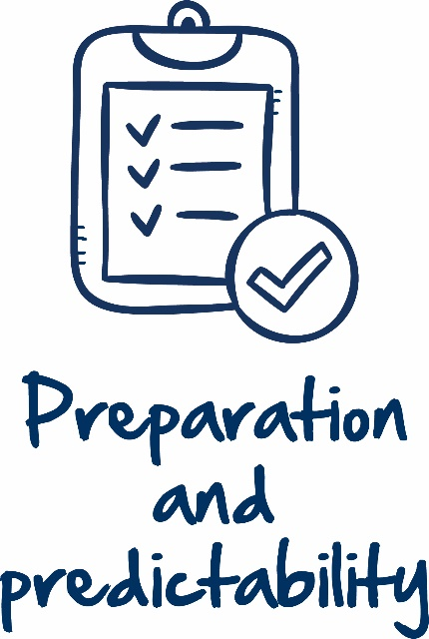
Wide Range of Options
There are a wide range of options to increase inclusivity in your environment
Environmental Assessments by people with disability
A range of resources (including visual stories, sensory maps, communication supports)
Accessibility information easily accessible on a website
Quiet rooms
Staff Training
Environmental adaptations (small and large)
Adapted programs or events
Community consultation

Slide 6
Small Changes
Comprehensive programs are developed over time, with the involvement of people with a disability
It is ok to start small
One or two options (e.g. environmental assessment and staff training or updating website information and developing a helpful resource) can have a big impact
Starting with one or two things and doing them well is better than having nothing at all and can have a big impact on the lives of people with a disability
Notes:
AAA Training Module image

Slide 7
Big impact
In 2022 Aspect surveyed participants in events held by our clients at a variety of public venues
98% of participants had accessed one or more resource developed (visual story, sensory map, accessibility page on a website)
98% found them helpful
Every participant surveyed said they would be more confident returning to a venue again
Notes:
Visual representation of stats

Slide 8
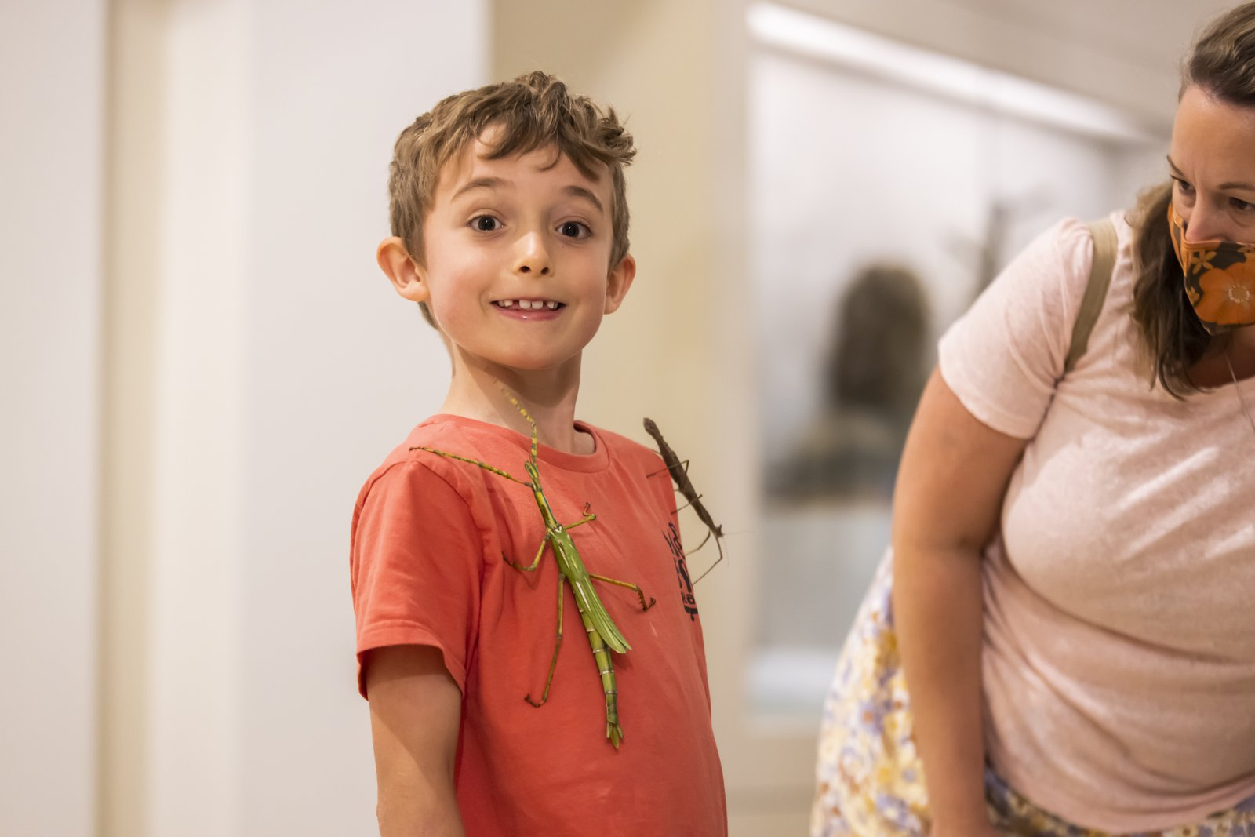
Examples of big impact
Australian Museum - “look mummy its my story, its here”
Mardi Gras – “I came because I knew there was a safe space for me to go and I had all the information I needed”
West Tigers – “I got to experience a live footy game with my son, something every dad should be able to do”

Slide 9
Get in contact with the Autism Friendly Team to find out more
Email:
autismfriendly@autismspectrum.org.au
Website:
https://www.autismspectrum.org.au/get-involved/making-australia-autism-friendly

